Slide 1
Family Engagement
Certified Family Partners as part of the Multi Tier System of Supports
for School Based Mental Health programs

Slide 2
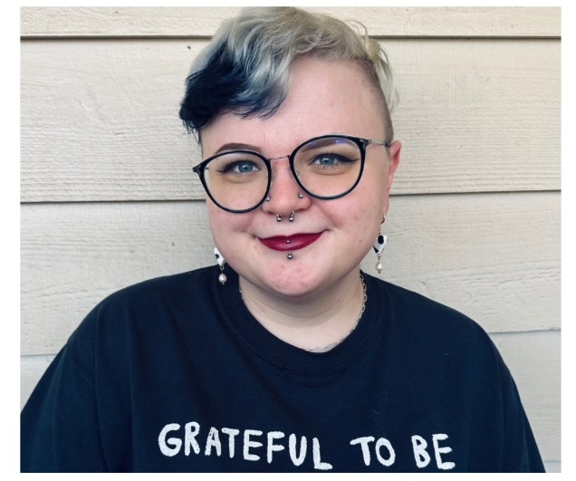
ABOUT Taylor
Taylor Morgan, LMSW (she/her)
Taylor is a graduate of the University of Colorado’s social work program. She earned her Bachelor’s degree in Psychology from the University of Texas.
She is part of Integral Care’s school based services program.
She has worked with children and families in multiple settings, including hospitals, residential facilities, outpatient programs, and crisis response.
She provides individual, group, and family sessions to help children and families in meeting their goals.
Notes:
TAYLOR

Slide 3

About Leah
Leah Marie Kelly (she/her) , Certified Family Partner, Integral Care
My husband and I are parents to a teen Autistic daughter who also has co-occurring mental health issues – depression and anxiety, ADHD, PTSD, and a vision impairment. We have been navigating systems for and with Harper for thirteen years.
I’ve worked as a Certified Family Partner at Integral Care of Travis County in Austin, Texas for the last two years and three months.
I am passionate about supporting families in reaching goals they have established for themselves.
I enjoy spending time with my dogs, traveling to the Pacific Northwest, and taking care of my plants.
Notes:
I am going to use a deck of slides today because I am a nervous nelly and they help to keep me from going off on a tangent.
SO…to begin with I’ll give you a little of background about me. I’m a parent of sixteen-year-old daughter who is Autistic *and* has co-occurring mental health issues – I used to lovingly refer to it as alphabet soup, depression and anxiety, ADHD, PTSD, and she also has a visual impairment. My family’s been navigating systems for - and with - Harper for thirteen years. I also have two other adult children.
I don’t know how it happened but I somehow got very involved in my kiddos school district. I have served on the Campus Advisory Committee, Campus Equity Advisory Committee, Special Education Advisory Committee, School Health Advisory Council, and SHAC mental health subcommittee.
I have been a Certified Family Partner at Integral Care in Austin, Texas for the last two years and three months, but who’s counting?
I firmly believe families should direct their own goals. I just think that when people are included in creating solutions they are more invested in the outcomes.
I came to this work through my family’s personal experiences in special education and the health care system because I wanted to share the successes that we have had and hope that things can improve.

Slide 4

The gift of my job
Notes:
When I am sharing publicly I feel like it just makes sense to tell you a little about my youngest daughter who is the reason I found my way to this work. I also always want to let people know that I DO have her permission to share about her experiences.
This slide has photos of her from her first day of kindergarten through her junior year of high school with her teachers and some of the mental health professionals we have worked with over the years. I could tell you a story about how each one of these people has touched our lives.
I am also married to a teacher of 21 years and the daughter of a retired teachers of, idk, more than 21 years.

Slide 5
Topics we will talk about today
Peer
Support
What is family partner support?
Benefits of peer support.
Partnering
with
Districts
What is our referral process?
A typical day for me.
Impact for
Families
Who are the communities I work with?
The impact I have noticed.
Notes:
So I hope to get through these topics today.
Peer support, what it is and how it benefits people. I also just want to share right off the bat that when I talk about peer support during our conversation today I want everyone to know that family partners are under that umbrella, and are a type of peer support.
What it looks like when family partners partner with a district, and what our specific referral process looks like for my organization.
And then lastly, the communities that we work with and some of the outcomes I have the privilege of being a small part of.

Slide 6
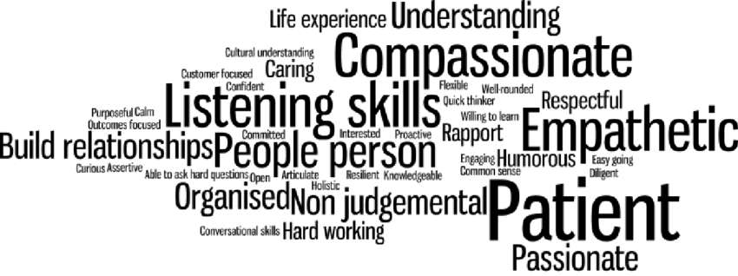
What comes to mind when you hear the term “peer support?”
Notes:
What do you think of when you hear peer support?
Ask people to add what comes to their mind in the chat if it is available on the webinar platform.
[WAIT TIME]
Patient
Understanding
NON judgmental
People person
Caring
Lived experience

Slide 7

Peer support is…
“Broadly defined, “peer support” refers to a process through which people who share common experiences or face similar challenges come together as equals to give and receive help based on the knowledge that comes through shared experience.
A “peer” is an equal, someone with whom one shares demographic or social similarities. “Support” expresses the kind of deeply felt empathy, encouragement, and assistance that people with shared experiences can offer one another within a reciprocal relationship.”
https://www.samhsa.gov/sites/default/files/programs_campaigns/brss_tacs/peer-support-2017.pdf
Notes:
This infographic linked in the QR code was created by SAMHSA, Substance Abuse and Mental Health Service Administration.
I am not going to read this entire slide to you but I wanted to let you know you might want to scan and refer back to this infographic later.
I am just going to touch on some of the positive outcomes that are listed that stand out to me.
Increased self-esteem and confidence
Increased sense of control and ability to bring about changes in their lives
Increased sense of hope and inspiration
Increased empathy and acceptance (camaraderie)
Increased engagement in self-care and wellness
Increased social support and social functioning
Decreased substance use and depression
How could anyone not want these more positive outcomes of the families we are supporting?
Taylor, Can you talk a little about the outcomes you notice on the campus? (attendance, engagement, grades, fewer suspensions, referrals, etc.)

Slide 8

PARTNERS
CLASSROOM TEACHER
SCHOOL SOCIAL WORKER
INTEGRAL CARE THERAPIST
FAMILY PARTNER
FAMILY
CHILD
Notes:
TAYLOR – school referral process
And I just want to add that all these grey arrows in the middle of this graphic are meant to illustrate the complexity of this small system. The family partner’s role is to help parents navigate systems, but you can also see there is no direct line from the family partner to the child, because family partners do not work directly with children.

Slide 9
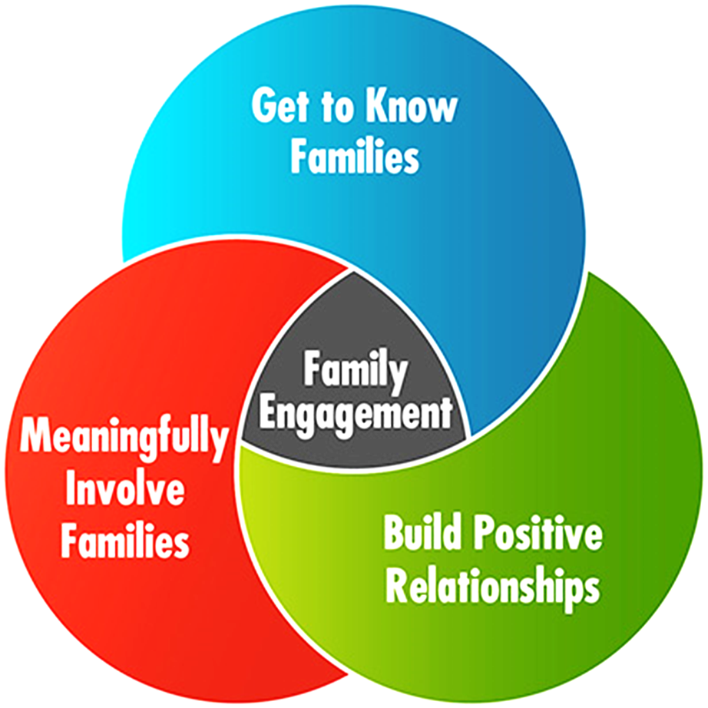
Connection Methods
Engaging with families through home visits, community visits, phone calls, and online platforms.
Comprehensive Support
Ensuring families receive holistic support, including healthcare, food security, housing, parent skills training, and emotional well-being.
Supportive Services
Include a wide variety and flexibility such as assisting with food access, SNAP and Medicaid applications, school enrollments, doctor appointments, resource connections, and emotional support.
Collaboration
Working across three school districts and multiple campuses to reach families and make connections.
Notes:
There really is not such a thing as a typical day. Every day is very different.
Since I cover three districts it would not make sense for me to have an office on campus so I work mostly from my car.
I meet with families everyday over the phone, on TEAMS, in person at coffee shops, playgrounds, doctor offices their homes – wherever they are comfortable.
A lot of times I find myself helping families with food insecurity early on because that is often a pressing need. Then as we start to develop some trust we might start working on finding housing, or health insurance.
I have worked with several families who have CPS involvement. Sometimes when you parent children with very big behavior it invites the need for more outside support. All of the families in this situation have said they were thankful to have someone support them through that time.
Everyday is different – and I really enjoy that!

Slide 10

Community outcomes
I work with ANYONE interested in family partner supports.
Outcomes:
Families feel connected, valued, and more engaged.
Some families have improved economic income.
Some families have more stability, less moving, that leads to better academic outcomes.
Some families have better health outcomes.
Families feel less isolated and alone.
Family empowerment to support others in their communities!
Notes:
Leah and Taylor will speak about specific outcomes that have been positive in families’ lives.
Family living in transitional housing, mother went back to school, secured a better paying job, completed Nurturing Parent, improved credit score from 450 to almost 700 now, currently looking to purchase their first home!
Father with no access to medical care, has gotten a primary care physician, medication to manage diabetes, and just a new prescription and pair of eyeglasses.
Several families with multiple children have moved from shelters, their cars, being doubled up with friends into stable housing.
Families have kept children in their homes by working together with CPS or others are currently working towards reunification by completing parent skills classes, working on housing, and maintaining steady employment.

Slide 11

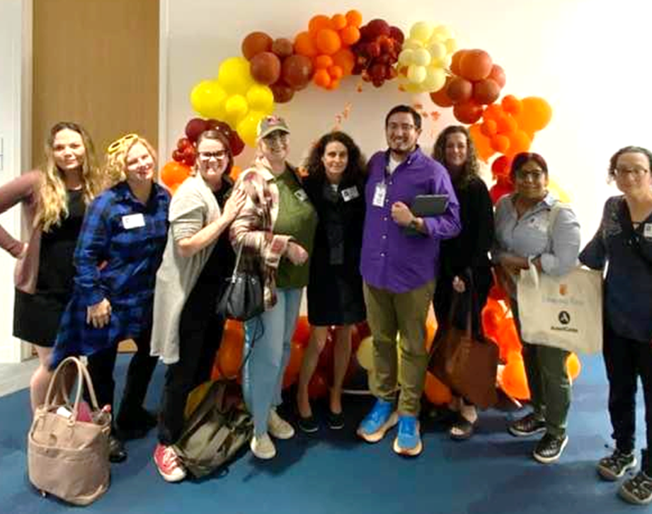
GRATITUDE
Notes:
I really want to end with expressing my gratitude there are people in this field who recognize the value parents have to contribute.
In my opinion, family voice is a critical part of the solution and I am honored to be able to help facilitate including parents around ALL of the tables – but especially the tables where their children are being affected.
For me, having a community, being part of something bigger, it goes a long way to mending relationships and developing trust.
So, thank you for inviting me to share about something that means so much to me.
Happy to answer any questions anyone might have.

Slide 12
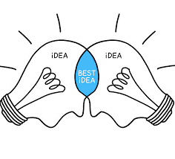

questions

