Slide 1
Substance Use Prevention – Resources and Programs for
Texas Schools
Kaleigh Becker, MPH
Texas Targeted Opioid Response
Behavioral Health Services
October 18, 2023

Slide 2
Agenda
Substance Use Trends
Fentanyl
Substance Use Prevention
Texas Targeted Opioid Response (TTOR)
Programs and Resources
  Opioid Surveillance Dashboards
  PAX Good Behavior Game
  Youth Programs
  Fentanyl Awareness Campaign
  Opioid Misuse Public Awareness Campaign
  Safe Drug Disposal
  Heroes Helpline

Slide 3
Substance Use Trends

Slide 4

Fentanyl

Slide 5
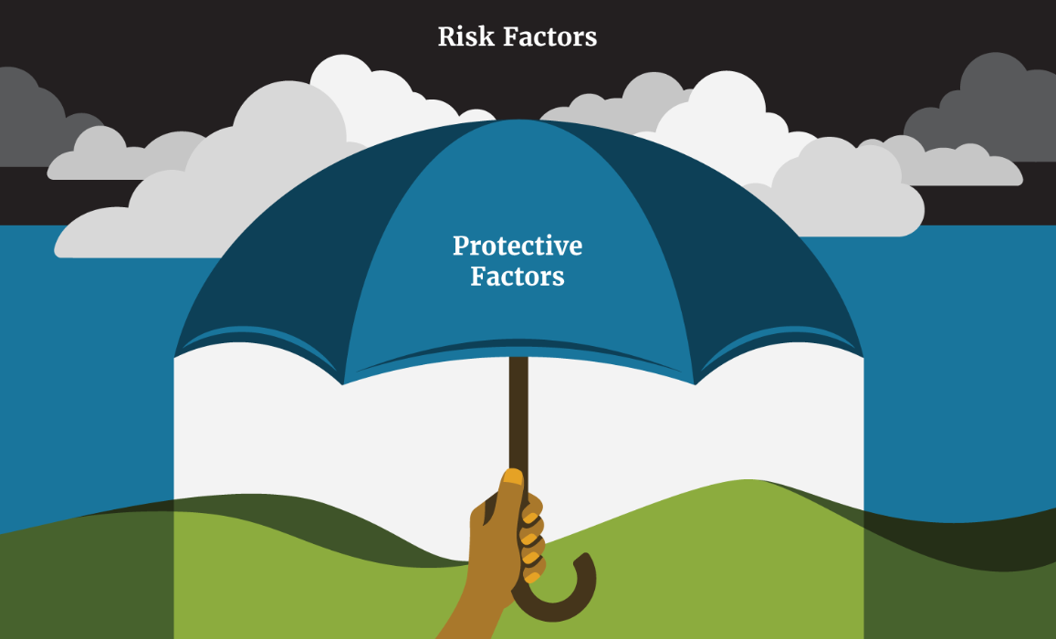
Substance Use Prevention

Slide 6
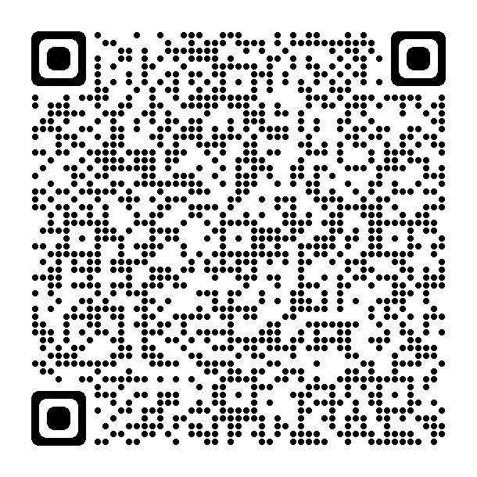
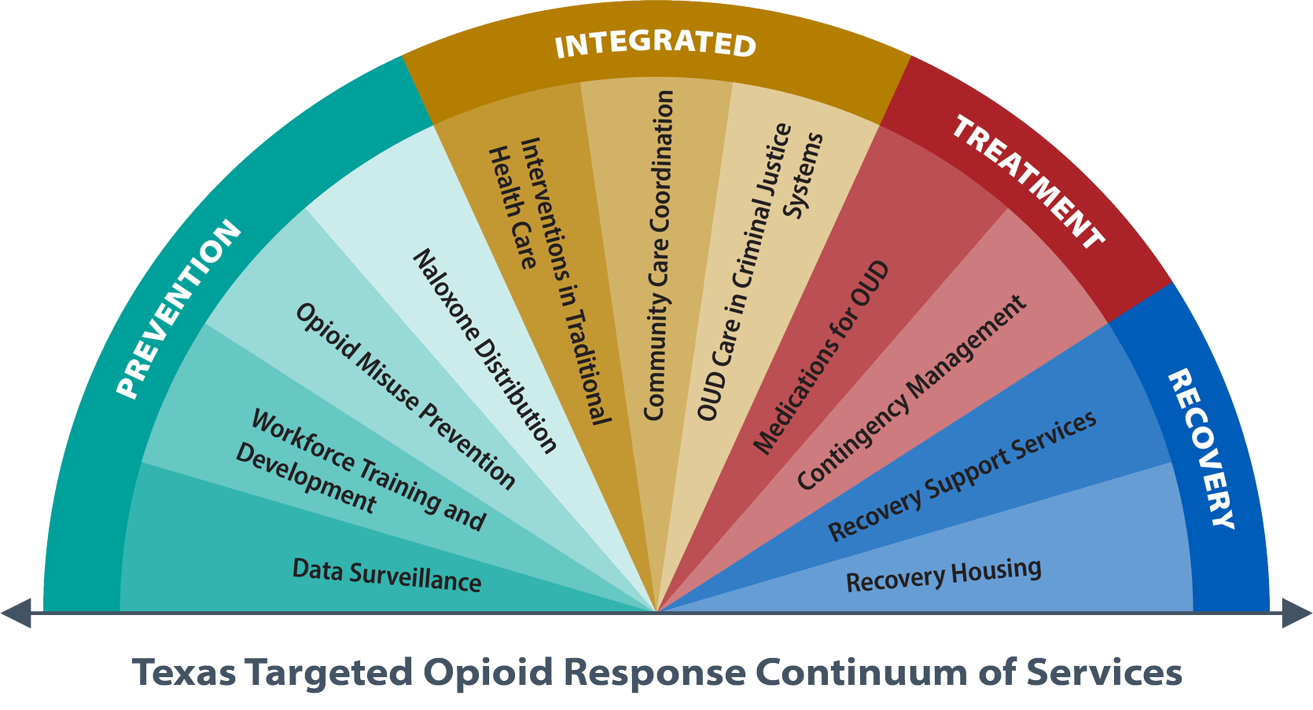
TTOR

Slide 7
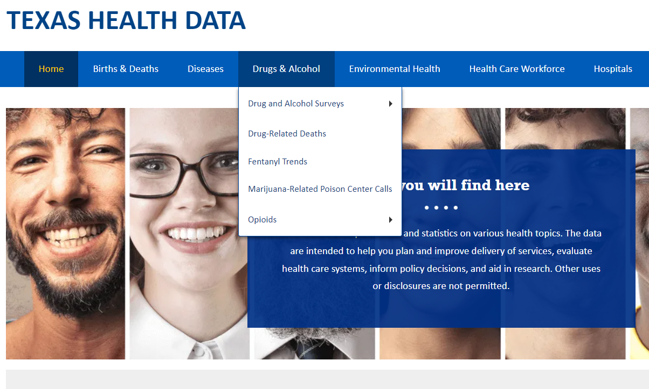
Opioid Surveillance Dashboards
The Texas Health Data website provides data on the prevalence and impact of opioids in Texas.
Dashboards:
  Drug-related deaths
  Alcohol and drug surveys
  Emergency department visits
  Poison center calls
  Prescription Monitoring Program
HealthData.dshs.texas.gov

Slide 8

PAX Good Behavior Game
A prevention intervention applied by educators in the classroom
Consists of evidence-based strategies to help build children’s self-regulation skills
Positive outcomes include reduced substance and opioid misuse
TexasGoodBehaviorGame.org

Slide 9
Youth Programs (1 of 2)
Find Your Local Provider
TexasPreventionTraining.org/Provider-Directory
Populations of Focus
Youth Prevention Universal (YPU): focus on the general population
Youth Prevention Selective (YPS): focus on subgroups of the general population
Youth Prevention Indicated (YPI): focus on people in high-risk environments
Notes:
PBHP’s YP programs currently provide services in 187 of the 254 counties in Texas. The curriculum includes All Stars, CBSG, LifeSkills Training, Positive Action, Strengthening Families Programs, and Too Good For Drugs
YPU focuses on general population without consideration of individual differences in risk for substance use/misuse
YPS focuses on subgroups of the general population that are determined to be at risk for substance use/misuse
YPI focuses on people in high-risk environments who have minimal, yet detectable, signs or symptoms of misuse
Examples of under-served populations: populations with demonstrated health disparities including POC, individuals living in Colonias, military/veteran families, tribal communities, individuals experiencing homelessness, rural communities, LGBTQ+

Slide 10
Youth Programs (2 of 2)
Youth Prevention Curricula
All-Stars (YPU and YPS)
Botvin Life Skills (YPU)
Curriculum-Based Support Groups (YPS and YPI)
Project Towards No Drug Abuse (YPU, YPS, and YPI)
Positive Action (YPU, YPS, and YPI)
Too Good For Drugs (YPU)
Strengthening Families Program
  7-session curriculum (YPU)
  10-session curriculum (YPU, YPS, and YPI)
  14-session curriculum (YPU, YPS, and YPI)
Notes:
YPU = Universal
YPS = Selected
YPI = Indicated

Slide 11
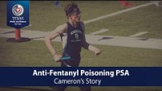
Fentanyl Awareness Campaign
Aims to raise awareness of the dangers of fentanyl and features testimonials from Texans whose families have been impacted by fentanyl poisonings
Resources:
  Educational content
  Testimonial videos
  Anti-fentanyl flyer
  Social media toolkit
  Resources
OnePillKillsTX.com

Slide 12
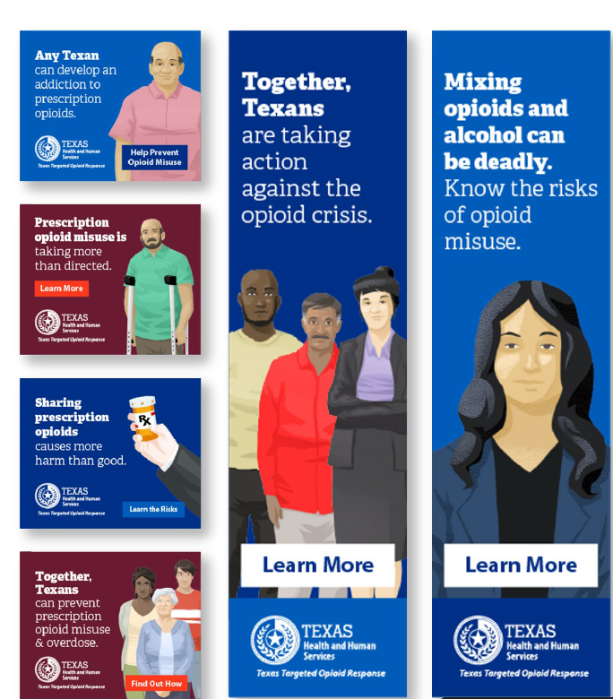
Opioid Misuse Public Awareness Campaign (1 of 2)
Aims to raise awareness of opioid misuse related dangers, risk mitigation strategies, and opioid use disorder treatment resources
Resources:
  Educational content and videos
  Social media guides
  Conversation guides
  PowerPoints
  Treatment and recovery resources
TxOpioidResponse.org

Slide 13
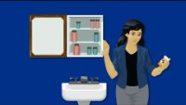
Opioid Misuse Public Awareness Campaign (2 of 2)
Notes:
Explain how to have a conversation with a young person about opioid misuse and treatment – use video to facilitate conversation. Conversation guides on website.

Slide 14




Safe Drug Disposal (1 of 2)
Locations
Stay Home
Drop Off
Methods of Disposal
Deactivation
Incineration
Overall, 14.3 million people aged 12 or older misused a prescription psychotherapeutic medication in the past year.
Of those who misused prescription pain medication, 51 percent obtained the medication from a friend or family member.
Proper storage and disposal of prescription medications is imperative to limit the improper usage of them.

Slide 15
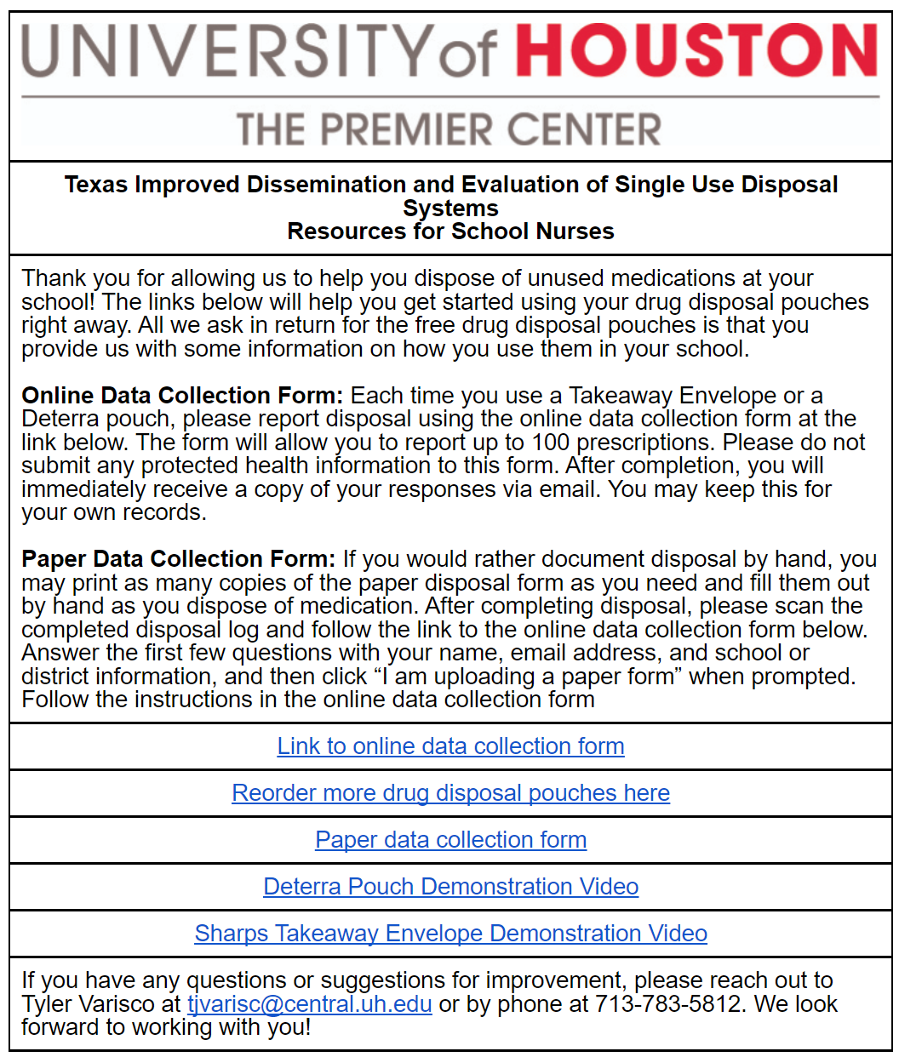
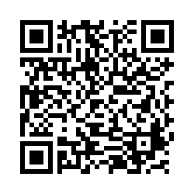
Safe Drug Disposal (2 of 2)
Project Email
PCUHCOP@central.uh.edu
Register your District or School

Slide 16

Resources: Overdose Prevention Education and Naloxone
Naloxone is a medication that can reverse an overdose from opioids, including fentanyl.
Overdose prevention training: keeplearning.uthscsa.edu/overdose-prevention-education-training/.
Standing order: txoti.org/naloxone-standing-order-request.
Where to get naloxone:
  Local pharmacy
  County sheriff's office
  MoreNarcanPlease.com
  Naloxone manufacturer

Slide 17

Resources: Outreach, Screening,
Assessment and Referral Services
OSAR programs are a starting point for people interested in substance use services to begin their path to treatment and recovery.
Find your local OSAR: hhs.texas.gov/services/mental-health-substance-use/mental-health-substance-use-resources/outreach-screening-assessment-referral.

Slide 18
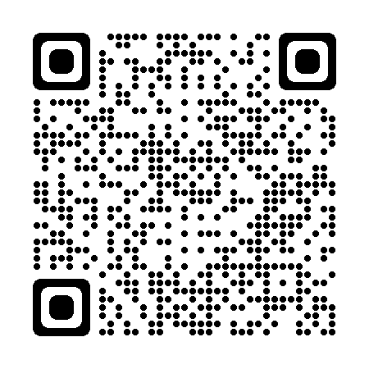
Resources: HeroesHelpline.org 833-367-4689
Available 24 hours a day, 7 days a week
Free and confidential support and referral service for first responders and healthcare workers to seek treatment without fear of judgment, stigma, or occupational threats
The Heroes Helpline will:
  Discuss substance use or mental health concerns
  Identify treatment options
  Provide referrals
  Offer follow-up, phone-based peer support by a certified Peer Recovery Support Specialist and navigate to social services
Notes:
Heroes Helpline is 24/7 Free

Slide 19
Thank You
TTOR@hhsc.state.tx.us

